Slide 1
WEBINAR DIGITALization of invoices

Slide 2
AGENDA
Strategy of VINCI Energies Belgium
Introduction Perimeter Buildings & Facilities
Organization of the Purchasing Department
Digitalization of invoices : how to proceed
Meeting Via Microsoft
Teams
Turn off the voice
Use the Chatbox for any questions (give yr name)

Slide 3
VINCI Energies Belgium
160.000 invoices a year
Issues
Some never arrive
Many arrive too late
Manual errors everywhere in the process
Payment status unknown to our vendors
Delays are linked to issues in the process
Identity fraud
3 Way match

Slide 4
For the future
Open Catalog Interface / Punch Out
https://www.konzmann.eu/products/purchasing
E confirmation in EDI
EDI
ePDF / Optical Character Reading

Slide 5
DIGITALIZATION of invoices
>800 invoices / year EDI & cost sharing
<800 invoices / year digital PDF free at disposal to our suppliers

Slide 6
AGENDA
Strategy of VINCI Energies Belgium
Introduction Perimeter Buildings & Facilities
Organization of the Purchasing Department
Digitalization of invoices : how to proceed
Meeting Via Microsoft
Teams
Turn off the voice
Use the Chatbox for any questions (give yr name)

Slide 7
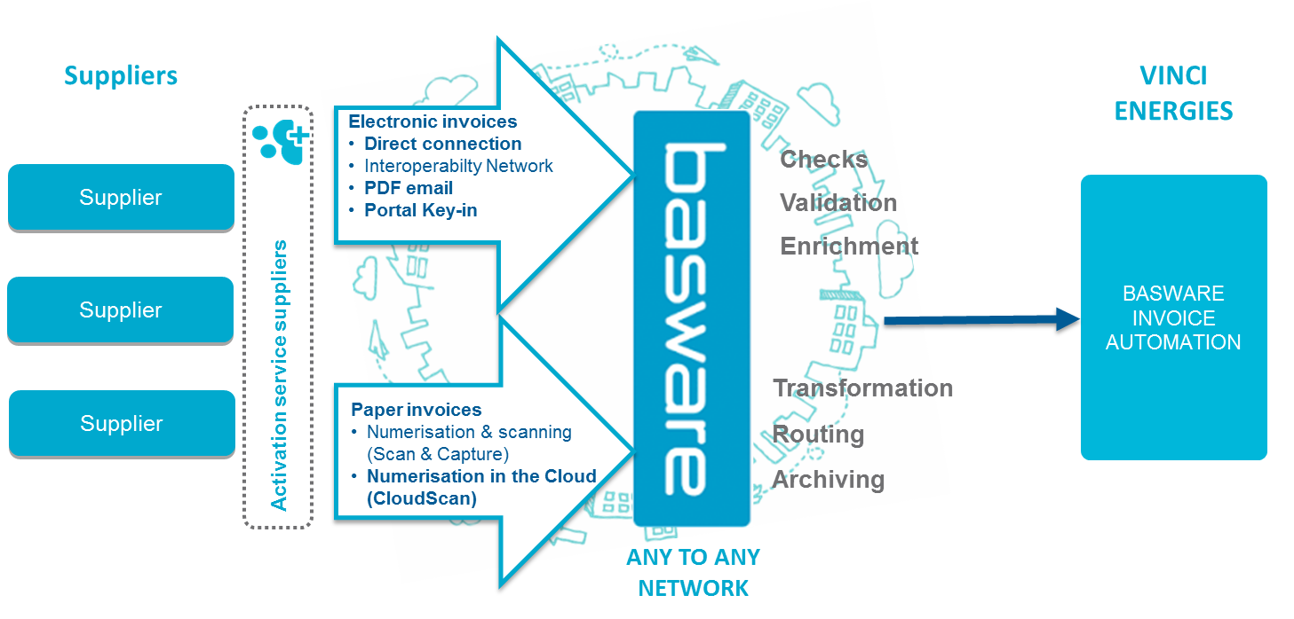
BASWARE SOLUTION OVERVIEW
ERP

Slide 8
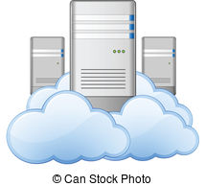
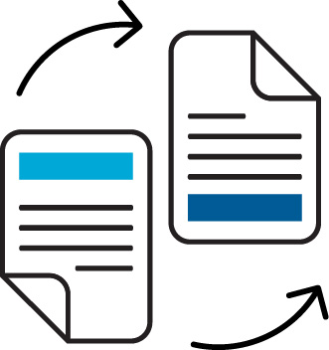
DIP – Project Overview Solution overview – incoming AP Processes
E-INVOICES, EDI, INTEROPS
ONLINE PORTAL
PDF E-INVOICE
PAPER INVOICE
CloudScan
INVOICE SENDER
(SUPPLIER)
BASWARE PORTAL
PDF
BASWARE
NETWORK

Slide 9
RECEIVING SOLUTION
THROUGH BASWARE
EDI (DIRECTION CONNECTION)
>800 invoices/year
Seperate projects
Extensive testing before go-live
Can be complex
Only for large invoice senders
e-PDF (PDF EMAIL)
>1 invoice / year if IT infrastructure
PDF in attachment of mail
Sent to Basware email address (one address per VE entity)
Basware extracts data from PDF
Basware validates data
No quality loss
Only after supplier is invited and has registered
Allows supplier to check status updates
(i.e. business info on invoice processing in SAP via portal for tracking)
PDF
BASWARE PORTAL
PORTAL KEY-IN
>1 invoice/year if no IT infrastructure
Supplier enters invoice data manually on Basware portal Supplier has to be invited
Supplier has to register
Supplier has to download auto generated PDF for his accountancy
Allows supplier to check status updates
(i.e. business info on invoice processing in SAP via portal for tracking)
PAPER
Extract data from paper
Cloudscan :
Supplier sends to VE entity postal address
VE scans locally with BW application
Data extraction & validation by BW
Scan & Capture :
Supplier sends to postbox
Scan partner BW scans
Data extraction & validation by BW

Slide 10
SUPPLIER KIT
How to send PDF-invoices to VEB
Contents
VINCI Energies is moving to electronic invoicing
Registration process
1. Use existing Basware account
2. Create an account
3. Fill in your company details
4. Add email address(es) for PDF invoices
Sending PDF invoices
5. Start sending PDF-invoices
6. Create a PDF-invoice
7. Attachment policy
8. Send the PDF-invoice
9. Invoice delivery
10. Mandatory content requirements for PDF e-invoice
11. Invoice validation and rejections
12. Invoice monitoring
13. VINCI Energies email addresses
Track your invoice status

Slide 11
Send invoices in e-PDF to VINCI Energies How to proceed ?
Create your account on https://portal.basware.com/open/PDFemailVinciEnergiesBelgium
Already using Basware with other partners ? You can re-use your account !
Send invoices by email to dedicated address
Using Outlook or directly your accounting system
Track you invoices via the Basware portal
Follow the treatment status in live

Slide 12
Create your account
Choose login & password
Confirm your account
Fill in your company info
List email addresses allowed to send ePDF invoices
Validate email addresses

Slide 13
Send your first e-PDF invoiCes
Create invoice in PDF format
Use your messaging software to create a new email
Attach the PDF invoice to your email
Want to add attachments to your invoice ? Simply add them to your email !
Send the email to the @email.basware.com address of the company you want to invoice

Slide 14
Track your invoices status
Connect to Basware portal
Search for a specific invoice or partner
Display details of the invoice
Check what is the status of your invoice

Slide 15
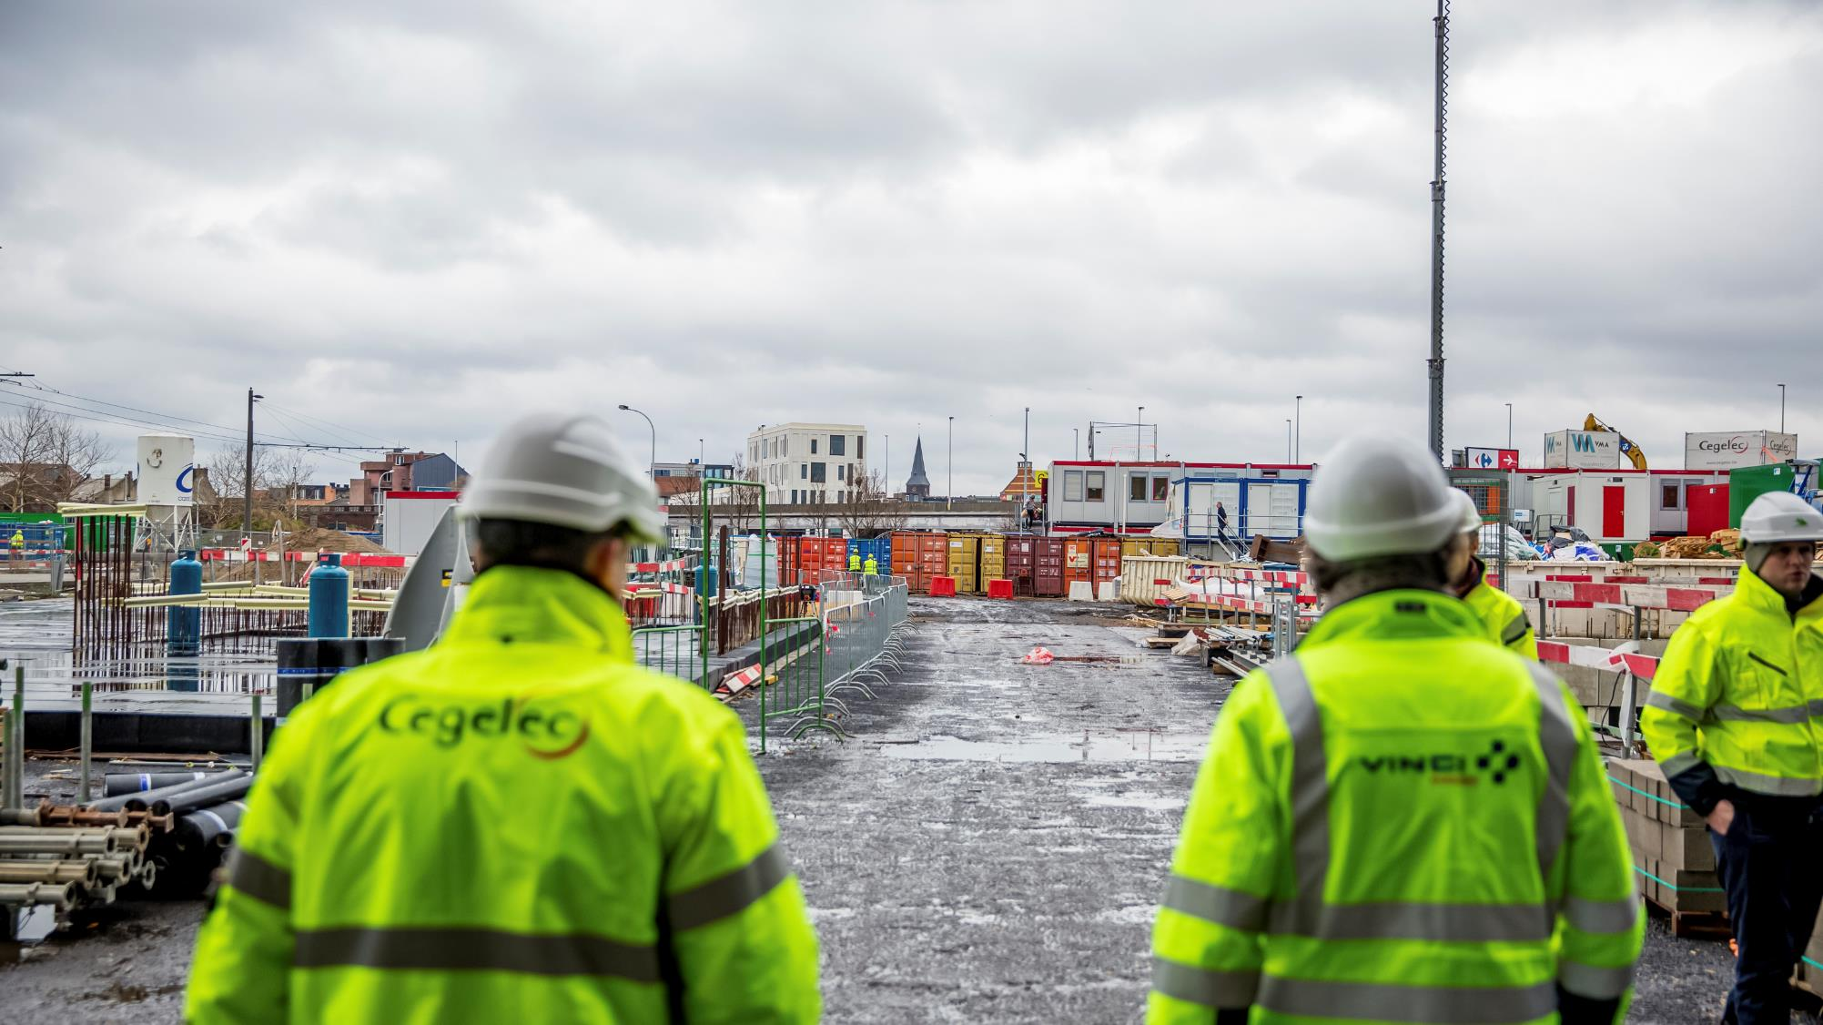
Thank you for your attention

